Slide 1


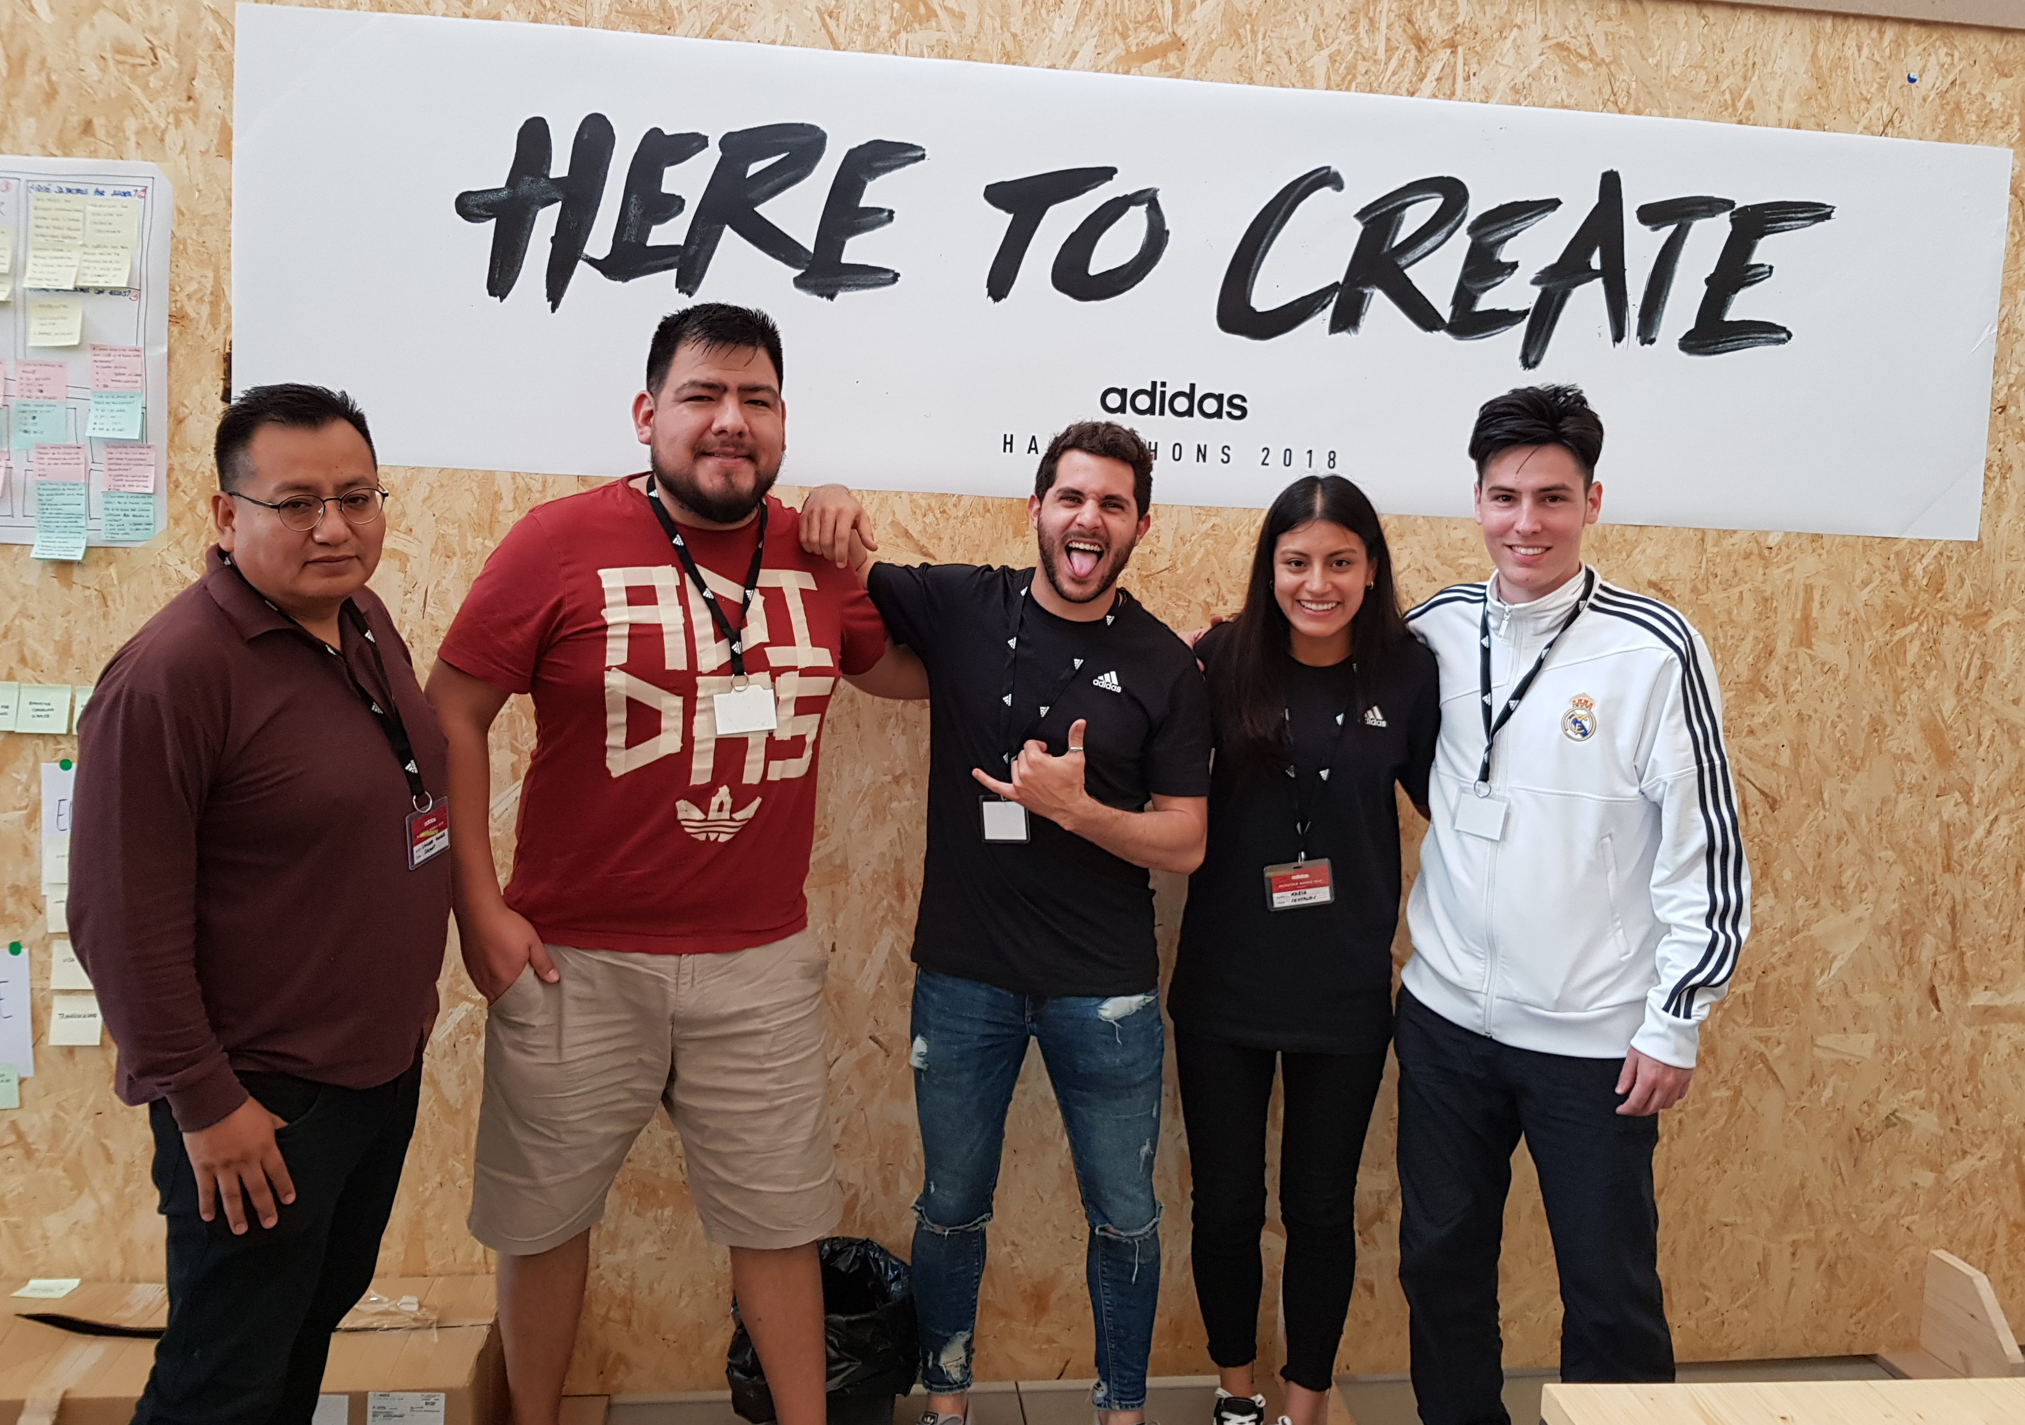


CENTAURY
TEAM PICTURE
Leonardo Gonzales
Juan Macias
George Félix
Victor Felipe
María Gonzales
ENABLE SPORT THROUGH TECHNOLOGY
Machine Learning
Dockers
TECHNOLOGIES
Big Data
React Native
IoT
Python

